Slide 1

Kairos Torch
                Walking the Journey with the Next Generation
2026 Kairos Annual Conference • Orlando, Florida
Juan Martinez and Ida Mae Wheeler
Welcome

Slide 2
The Journey
Kairos Torch is not just an event, it’s a journey with young men and women who are still forming identity, direction, trust, and hope.

Slide 3
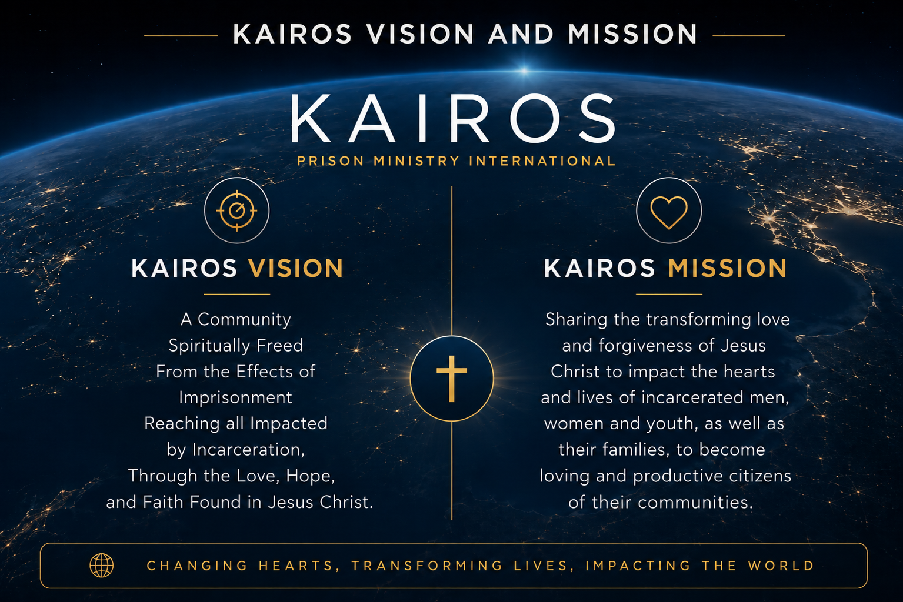
Kairos Vision and Mission

Slide 4
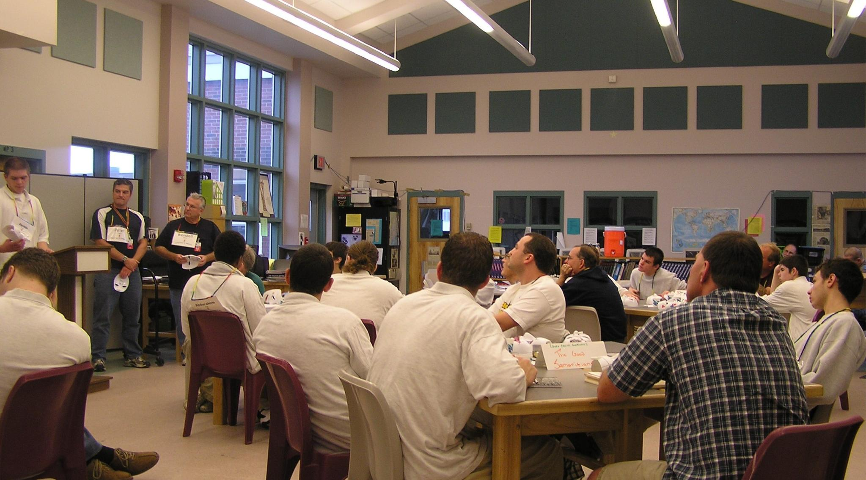
Kairos Torch:
From Need to Ministry

Slide 5
Kairos Torch:
From Need to Ministry
Tom Johnson explored “Torch” at the request of a federal prison chaplain in Miami, Florida
The need: serve younger inmates and provide a positive family experience
A co-ed model emerged with experienced Kairos volunteers and spouses serving younger inmates

Slide 6
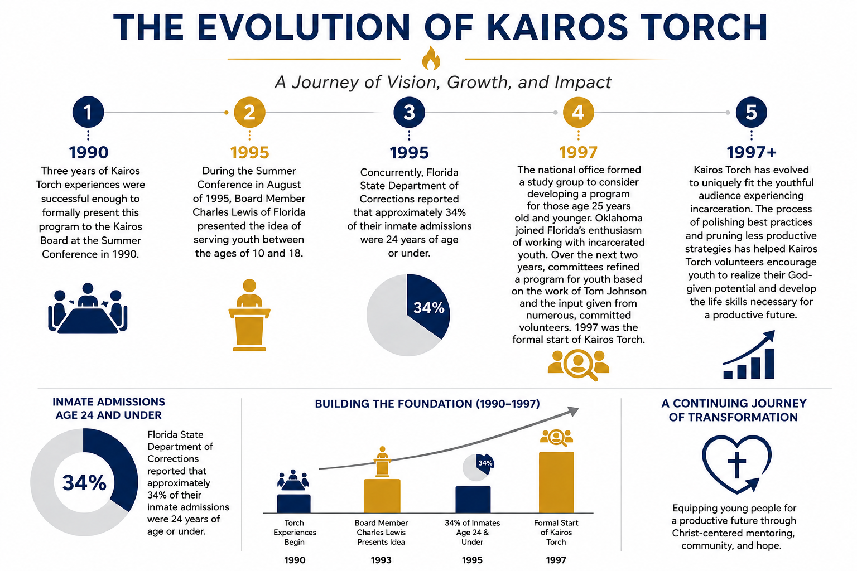
Advancing the Program

Slide 7
Why Kairos Torch Exists
Youth are still forming identity, direction, trust, and hope
Kairos Torch encourages youth to realize their God-given potential
Kairos Torch develops life skills necessary for a productive future
Kairos Torch creates a Christ-centered environment where young people can begin telling the truth

Slide 8
Four Guiding Questions
What happens when:
a young person encounters the love of Jesus before the trajectory of life becomes more deeply set?
someone who survives by wearing masks experiences a safe place to begin telling the truth?
volunteers continue walking with young people for six months?
God raises up mature peer mentors inside adult institutions?

Slide 9
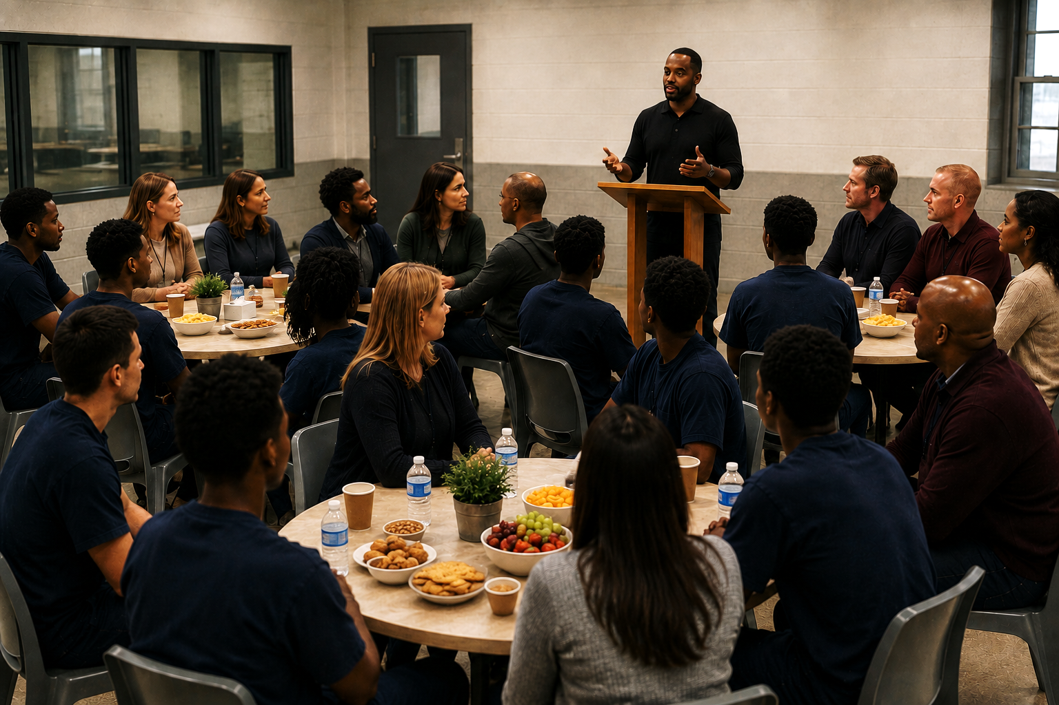
Mapping the Process Requires Passion
Forging relationships with facilities and volunteers requires a “spark”
Memorandum of Understanding, clearances, and trust open institutional doors
Ida’s spark: Southwest Oklahoma Juvenile Center, Manitou, Oklahoma
Juan’s spark: Marion,
Ohio

Slide 10
Team Preparation Shapes the Weekend
Key markers are introduced during team meetings
Volunteers experience the components before seeing them in the youth’s behaviors
Evidence-based transformation helps speak the language of institutional change
Group dynamics help leaders understand what is happening in the room

Slide 11
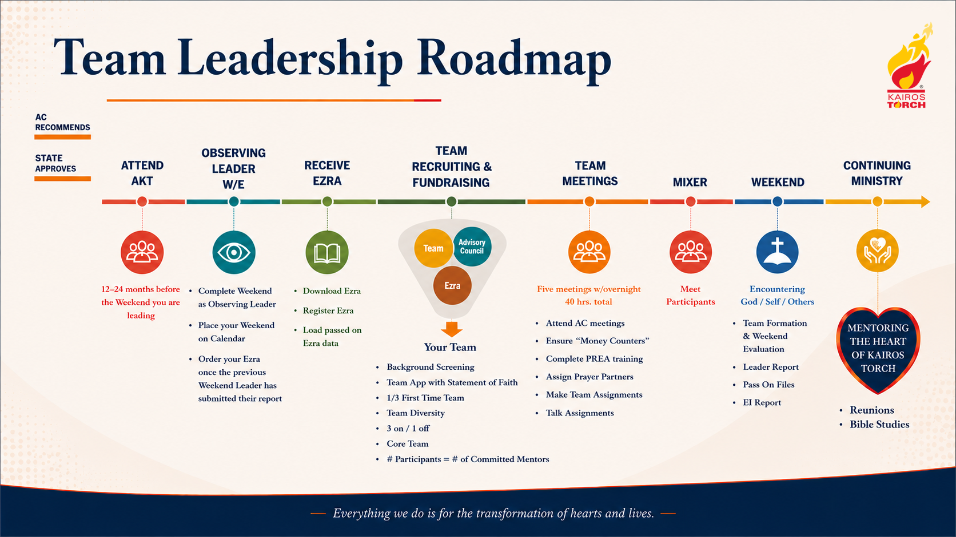

Slide 12
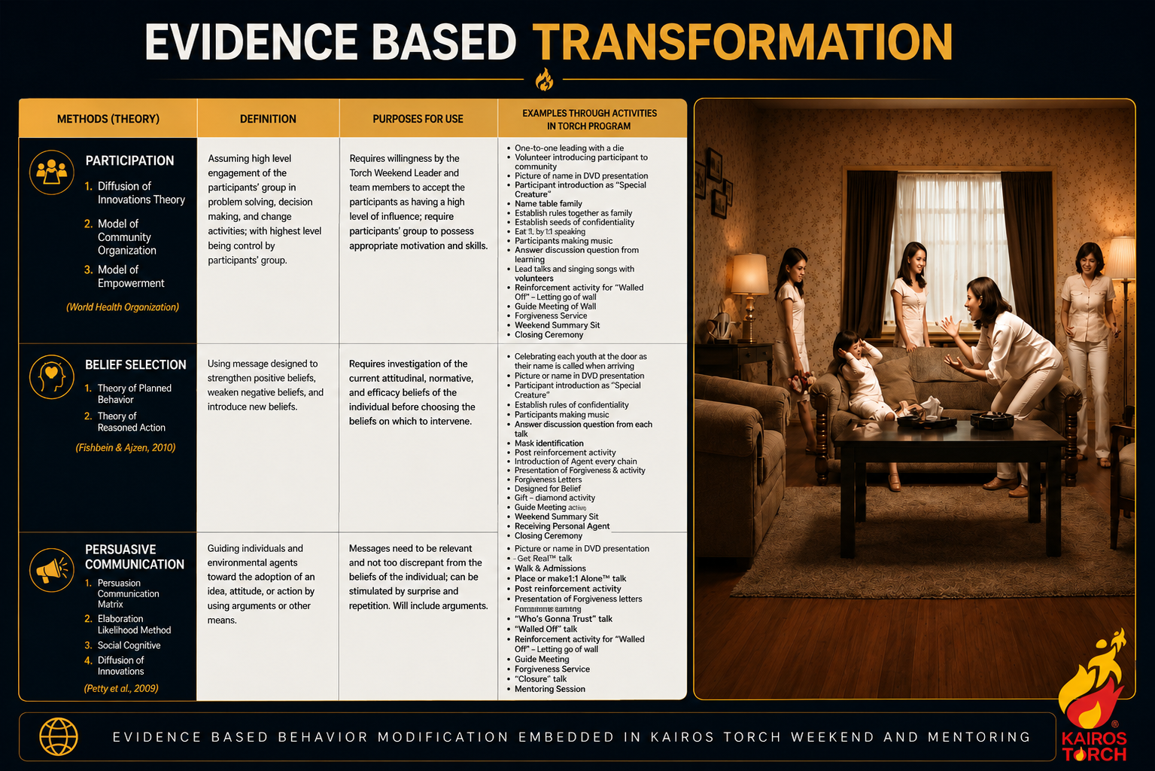

Slide 13
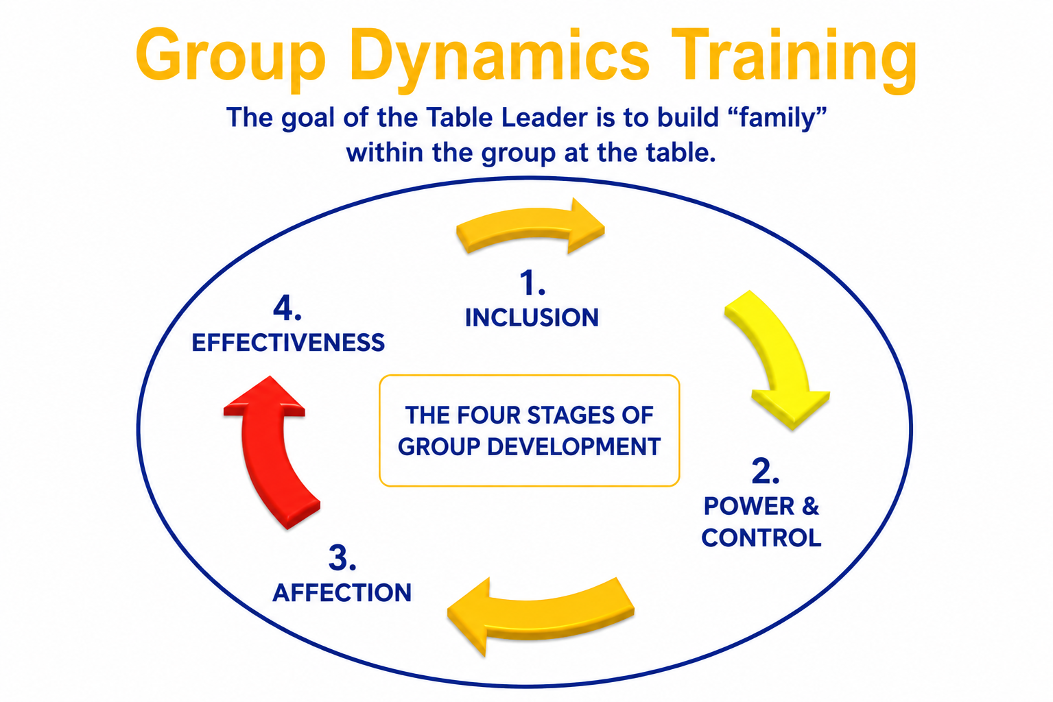
Group Dynamics Training

Slide 14
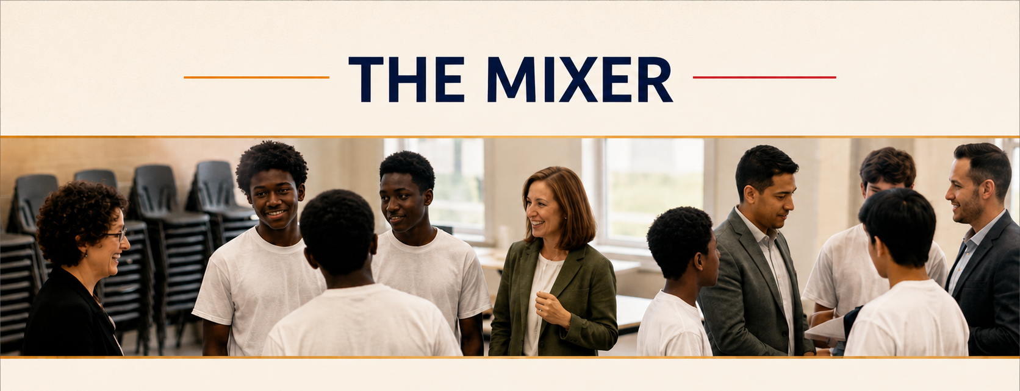
Participants and team members meet before the first day of the Weekend
Snacks and an interactive game are shared
Conversations help leaders observe trust, comfort, guardedness, or unease before mentoring pairs are made

Slide 15
The Kairos Torch Weekend
Welcoming Participants
Common experience as a group: snacks, introductions, Guide/Guidee conversations, and Creation video
7 Weekend talks with table family responses
6 Mask Meditations, Father Forgiveness, Forgiveness Service, and Guide Meetings

Slide 16
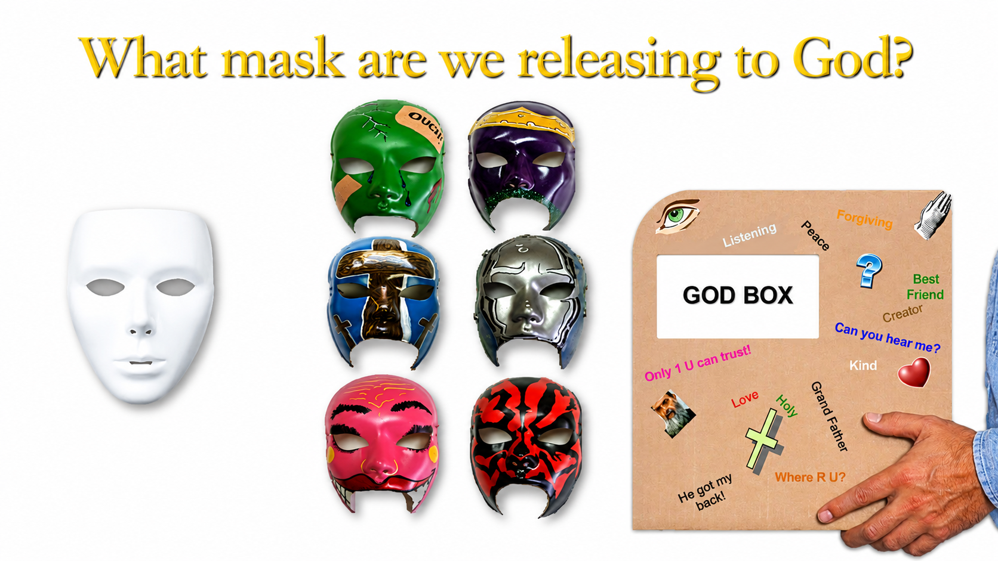

Slide 17
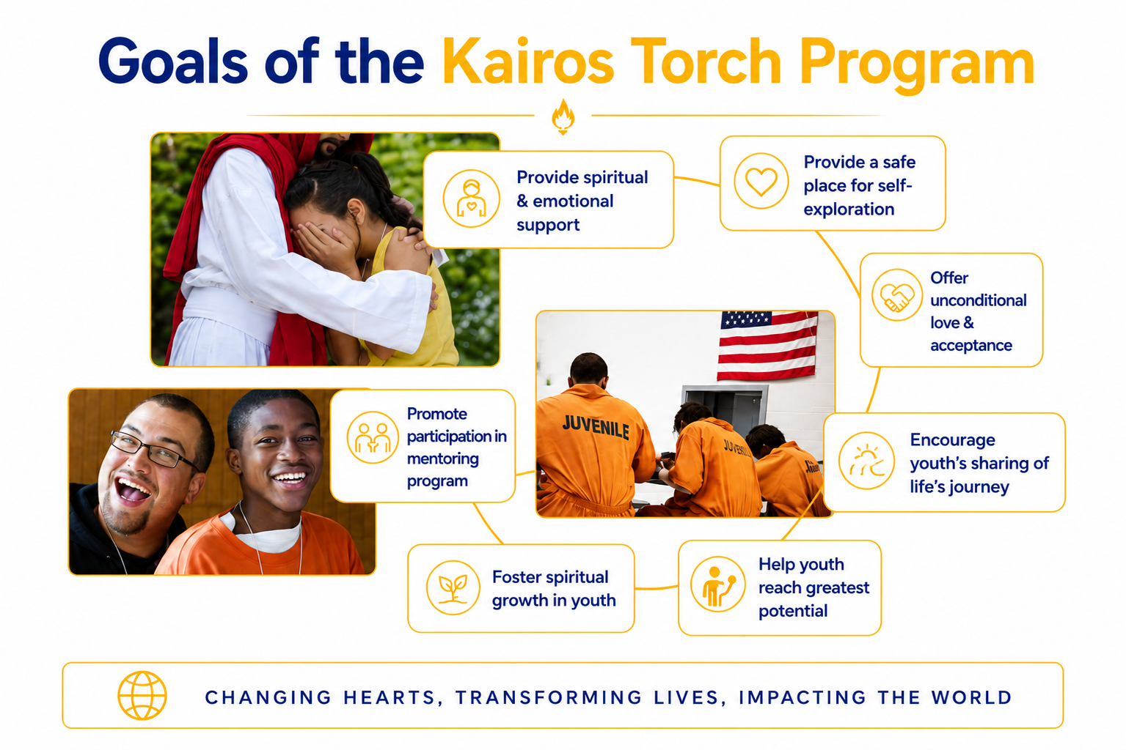
Ongoing Goals of Kairos Torch

Slide 18
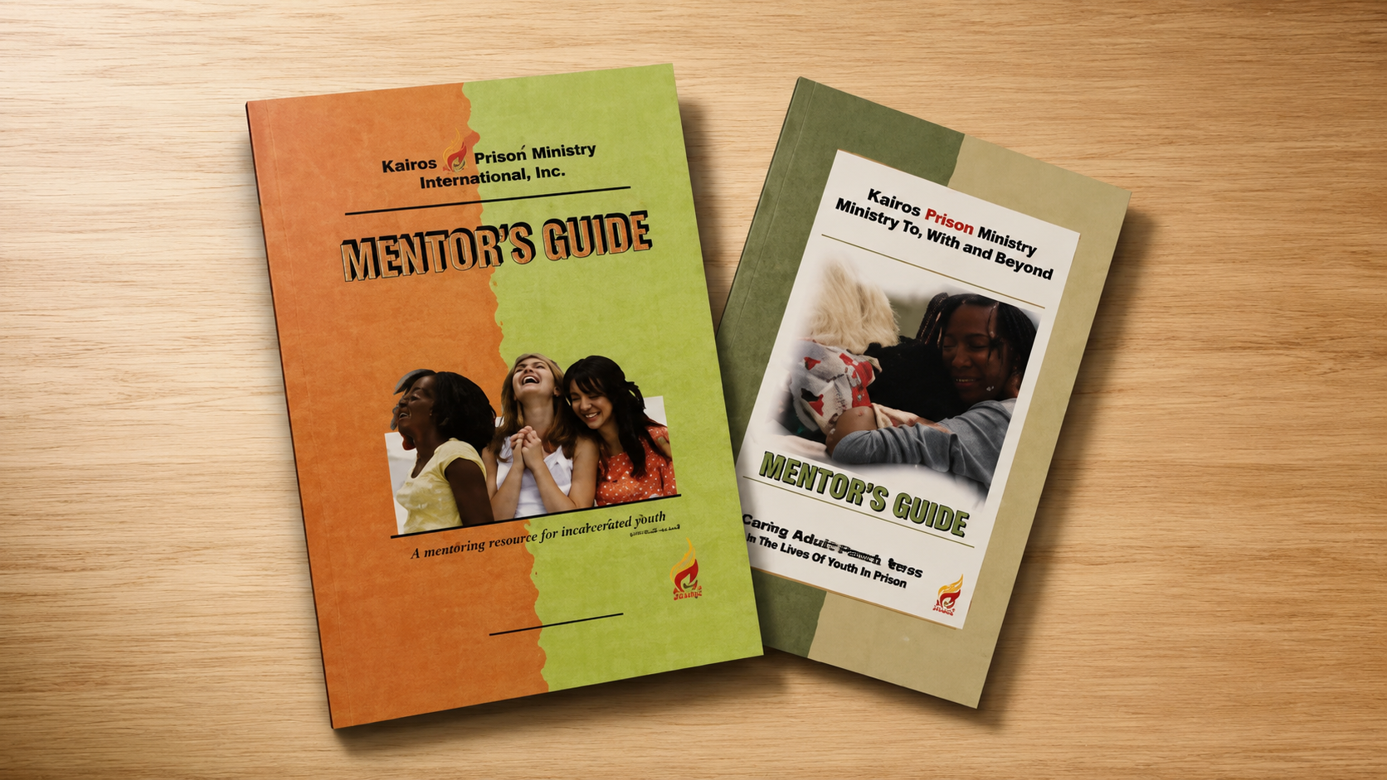
Continuing Ministry
The Weekend matters deeply,
but young people need more than a powerful Weekend.

Slide 19
What Young People Need After the Weekend
Consistency
Trusted relationships
Mature Christian presence
People who show up, keep showing up, and walk with them as they process identity, belief, wounds, choices, and future

Slide 20
Love Without Strings Attached
Not love because they earned it
Not love because they performed well
Not love because they said the right thing
Not love because they cleaned themselves up before they came
But love that reflects Jesus Christ

Slide 21
Questions They May Never Say Out Loud
Are you safe?
Are you real?
Are you going to leave?
Do you want something from me?
Can I trust you?
Will you still come back after you see who I really am?

Slide 22
Kairos Torch Introduces Something Different
A safe place
A table family
A mentor
A community
A journey

Slide 23
Weekly Mentoring
One-to-one mentoring in a group setting is the best practice
Use the appropriate Kairos Torch Mentoring Guide
Identify the best mentoring track for the time available with the youth and facility
Mentoring helps a young person experience the love of Christ over time

Slide 24
Monthly Reunions and Bible Study
Building Christian community
Integrating snacks, music, and celebration of the month
Continuing the journey after the Weekend
Creating a rhythm of belonging and spiritual growth

Slide 25
Why 25 and Younger Matters
Why focus specifically on 25 and younger?
Why does Kairos Torch matter as its own branch of Kairos?
Why is it not simply Kairos Inside for younger inmates?
The answer: young people are still “becoming.”
Young People Are Still Becoming
Their identity is still being formed
Their future patterns are still being shaped
Their view of God, self, authority, family, trust, love, and responsibility is still developing

Slide 26
Every Young Person Asks
Who am I?
Do I matter?
Can I trust anyone?
Am I more than what I did?
Is there still a future for me?
Can I change?
Can God love me?
Will anyone stay?

Slide 27
The Masks Young People Learn to Wear
What Lives Under the Mask
Toughness
Anger
Indifference
Humor
Silence
Performance
“I don’t care”
Fear
Shame
Grief
Confusion
Anger
Trauma
Disappointment
A deep desire to belong

Slide 28
How Does a Mask Come Off?
Not usually because we gave a good talk
Not usually because we told them they should lower their walls
Not because we have a volunteer badge
A young person begins to remove the mask when they believe the love is real, the room is safe, and the people will not disappear
Consistent Christian Presence
That does not happen instantly
It happens on the journey
It happens when someone shows up again, and again, and again
It happens through the faithful presence of Christ’s people

Slide 29
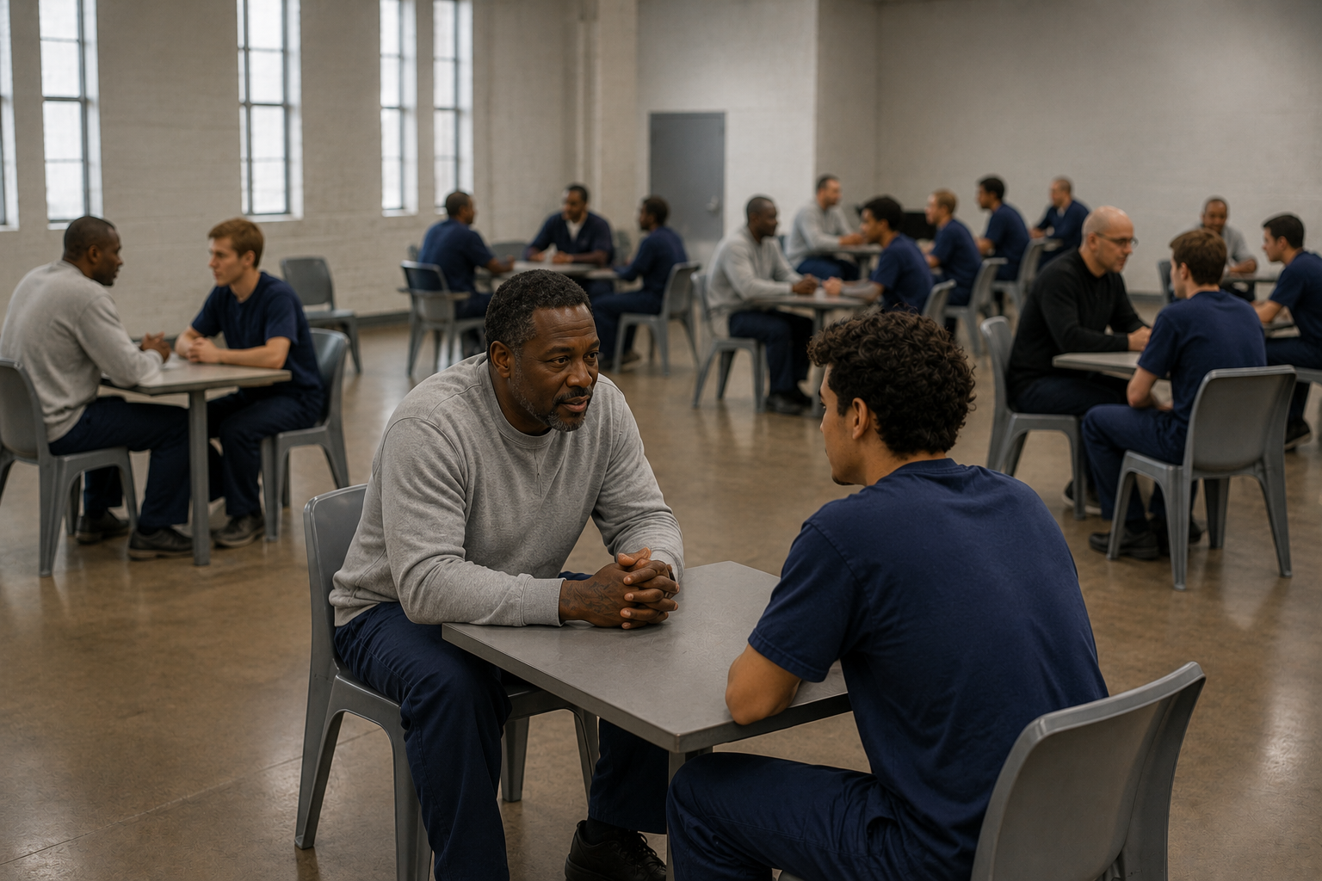
Mapping the Process Requires Passion

Slide 30
Changed Trajectories
If Kairos reaches someone at 45, that matters
If Kairos reaches someone at 25, we may be reaching a future father, mother, spouse, employee, church member, mentor, or community leader before destructive patterns harden more deeply
Kairos Torch is an opportunity to walk with young people early enough for the journey to change direction
We are not simply talking about program history.
We are talking about changed trajectories.
We are talking about young lives headed one direction until Jesus met them on the road.

Slide 31

Sacred Journey

